Slide 1
Kinetics in Fixed Axis Rotation Systems
Dr. Jacob Moore
Associate Professor of Engineering
Penn State Mont Alto

Slide 2
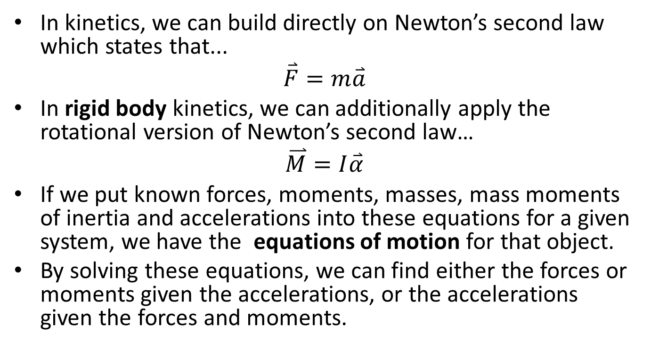
Newton’s Second Law and Kinetics
In kinetics, we can build directly on Newton’s second law which states that...
$$\overset{⃑}{F}=m\overset{⃑}{a}$$
In rigid body kinetics, we can additionally apply the rotational version of Newton’s second law…
$$\overset{⃑}{M}=I\overset{⃑}{α}$$
If we put known forces, moments, masses, mass moments of inertia and accelerations into these equations for a given system, we have the equations of motion for that object.
By solving these equations, we can find either the forces or moments given the accelerations, or the accelerations given the forces and moments.

Slide 3

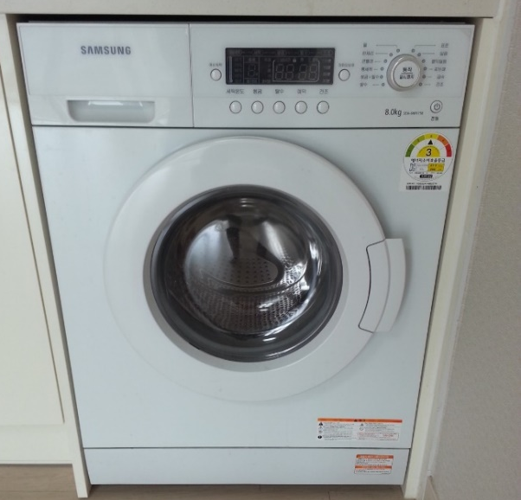
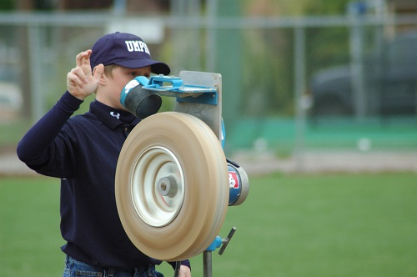
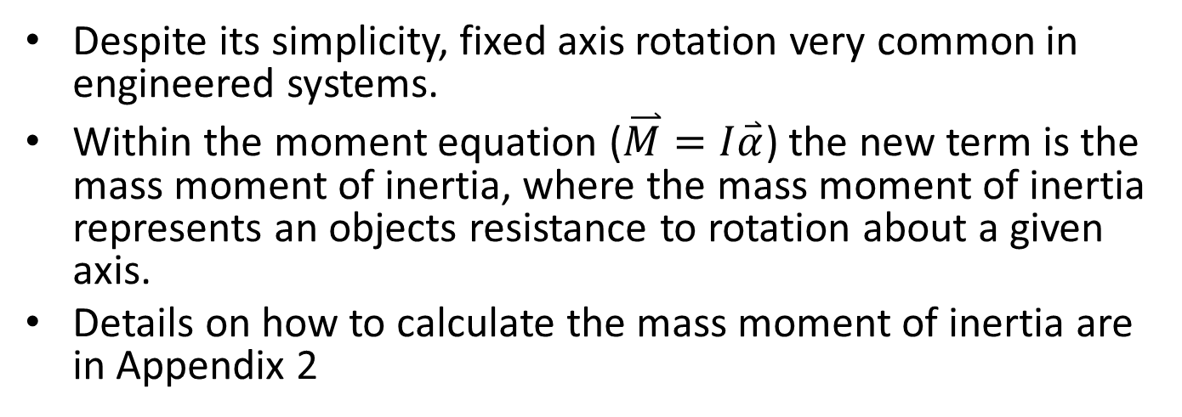
Fixed Axis Rotation and the Mass Moment of Inertia
Despite its simplicity, fixed axis rotation very common in engineered systems.
Within the moment equation ($\overset{⃑}{M}=I\overset{⃑}{α}$) the new term is the mass moment of inertia, where the mass moment of inertia represents an objects resistance to rotation about a given axis.
Details on how to calculate the mass moment of inertia are in Appendix 2

Slide 4

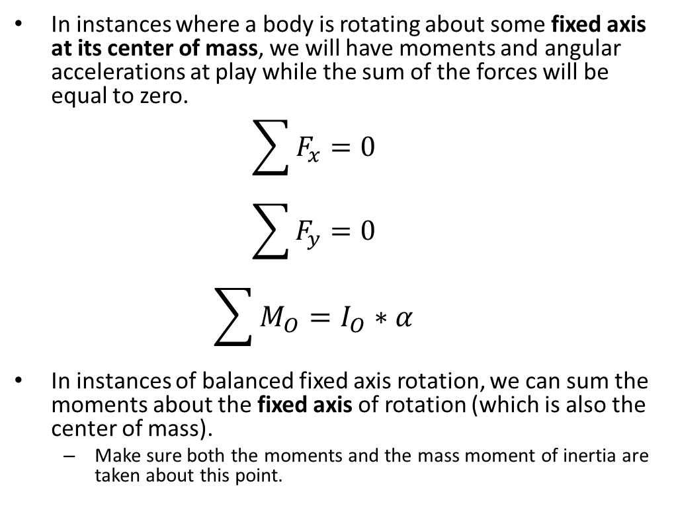
Balanced Fixed Axis Rotation Systems
In instances where a body is rotating about some fixed axis at its center of mass, we will have moments and angular accelerations at play while the sum of the forces will be equal to zero.
$$\sum{F_{x}}=0$$
$$\sum{F_{y}}=0$$
$$\sum{M_{O}}=I_{O}∗α$$
In instances of balanced fixed axis rotation, we can sum the moments about the fixed axis of rotation (which is also the center of mass).
Make sure both the moments and the mass moment of inertia are taken about this point.

Slide 5
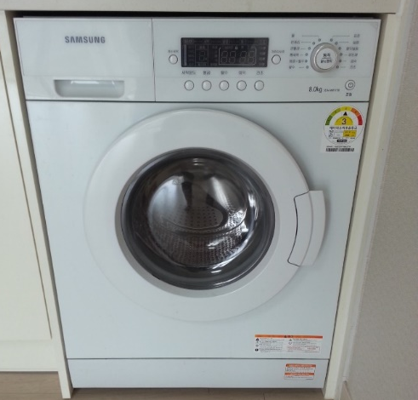
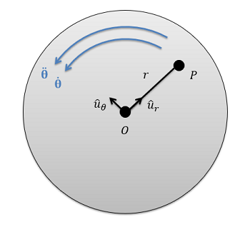

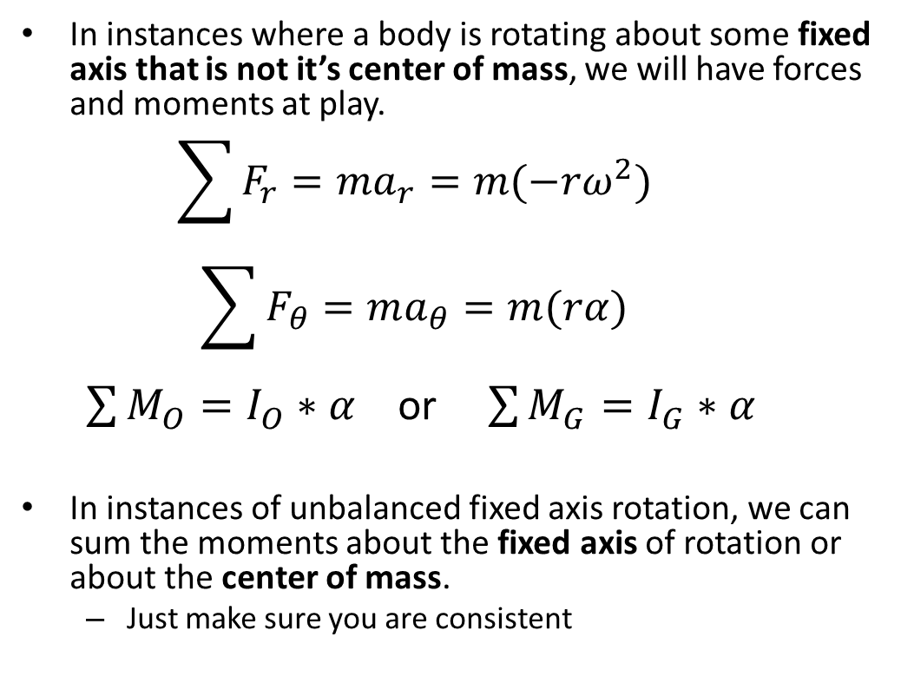
Unbalanced Fixed Axis Rotation Systems
In instances where a body is rotating about some fixed axis that is not it’s center of mass, we will have forces and moments at play.
$$\sum{F_{r}}=ma_{r}=m(−rω^{2})$$
$$\sum{F_{θ}}=ma_{θ}=m(rα)$$
$\sum{M_{O}}=I_{O}∗α$ or $\sum{M_{G}}=I_{G}∗α$
In instances of unbalanced fixed axis rotation, we can sum the moments about the fixed axis of rotation or about the center of mass.
Just make sure you are consistent

Slide 6
Solving a Rigid Body Kinetics Problem (The Process)
The process used in solving a kinetics problem is similar to solving a problem in statics and consists of three steps.
Set up a free body diagram.
Draw the body separated from it’s surroundings
Draw in all the known and unknown forces (I use red for forces) as well as key dimensions and angles (I use blue for dimensions and angles)
Draw in the acceleration vectors (I use a blue dashed vector for this)
Use the free body diagram to write out your equations of motion, breaking all forces down into x and y components, and writing out all the moments about the center of mass of the body or the fixed axis of rotation.
These may be supplemented with kinematics equations.
Solve the equations for any unknowns.

Slide 7
Thanks for Watching
See other engineering mechanics videos and access the full tool at…

Slide 8

Worked Example
An 8cm diameter hard drive platter accelerates at a constant rate of 150 rad/s². If the hard drive weighs a uniformly distributed .05 kg, what moment does the motor need to exert to accelerate the drive at this rate?

Slide 9

Worked Example
The drum in a washing machine can be approximated as a cylinder .4 meters in diameter and .3 meters in height with a uniformly distributed mass of 35 kilograms when full. If we wish to achieve an acceleration of 15 rad/s², what torque must the motor exert at the center of the drum
.4 m
M_{motor}
.3 m

Slide 10
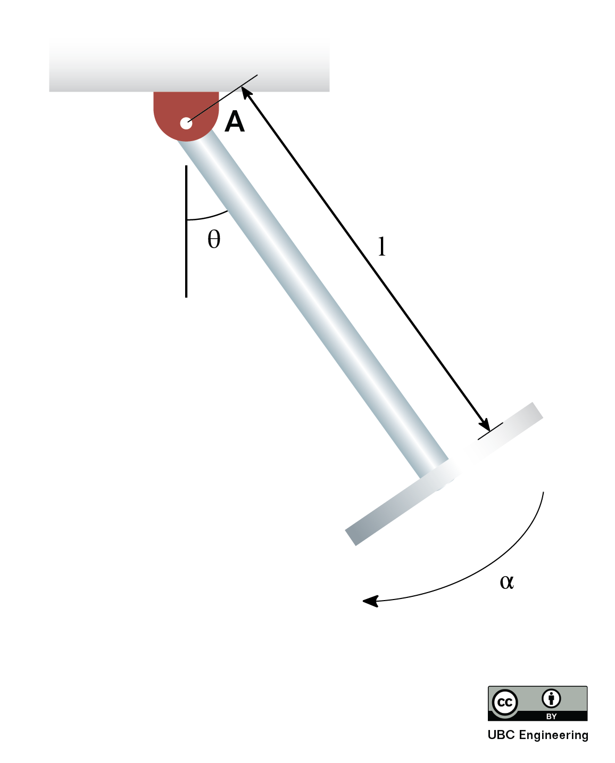
Worked Example
A hardworking engineer is developing a playground ride for her kid. If she determines that the maximum acceleration of an empty ride in the instant shown should not exceed 5 rad/s² due to safety reasons, what should be the length of the rod on which a 1kg seat is attached? The seat can be modelled as a thin disk with radius r=0.3m and the rod, no matter the length, has a mass of m=0.6kg. The angle in the instant shown is θ=45 deg. Choose the most realistic value for your final answer.

Slide 11
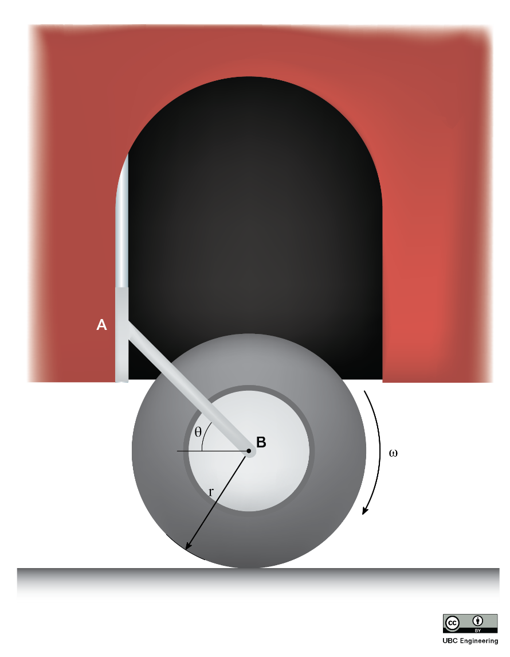
Worked Example
Students are creating a miniature all-terrain vehicle for a competition. An idea was proposed for an additional wheel which could be lowered and raised to dislodge the vehicle if it ever got stuck on jagged rocks. They decide to apply minimum constraint design to their prototype, resulting in a singular linkage arm attached to a wheel with radius r=0.15m at an angle of θ=30 deg. The wheel has a mass of m=5kg and a radius of gyration k_{B}=0.2m. If the students rev the wheel such that it initially spins with ω=30 rad/s, determine the reaction force exerted on the linkage AB. What is the time required for the wheel to stop rotating? The coefficient of kinetic friction is given as μ_{k}=0.4. Assume the linkage arm is securely locked in once it is lowered and neglect the mass of the linkage arm.

